Slide 1
Notes:
Abhijeet More

Slide 2
Team No. 5
Shreya Baderiya(127330)
Sakshi Piparsania(127319)
Sandesh Kadam(127323)
Rupshree Dutta(127536)
Pooja Patil(127446)
Savitha KS(127325)
S Sreelekha(127458)

Slide 3
AGENDA
Hardware
Windows
Linux
Network Fundamentals
Network Services
Database
Applications
Storage

Slide 4
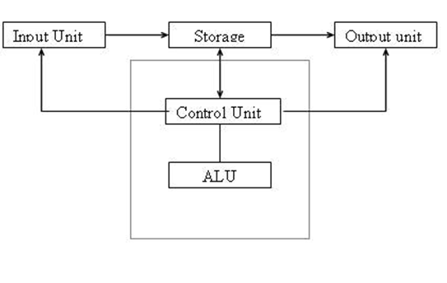
Hardware
Computer
It has-
Input unit
Output unit
Storage
Control unit
ALU

Slide 5
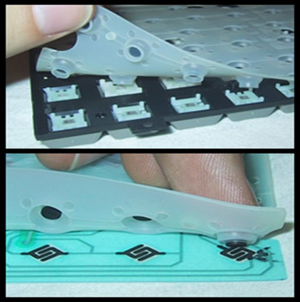

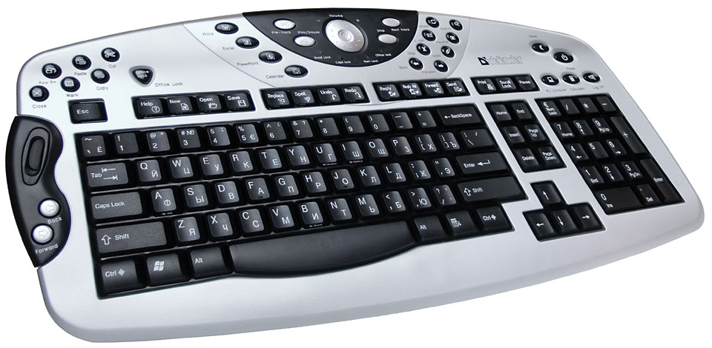
Input Devices
Keyboard
Types of keyboard
Mechanical
Membrane
multimedia

Slide 6
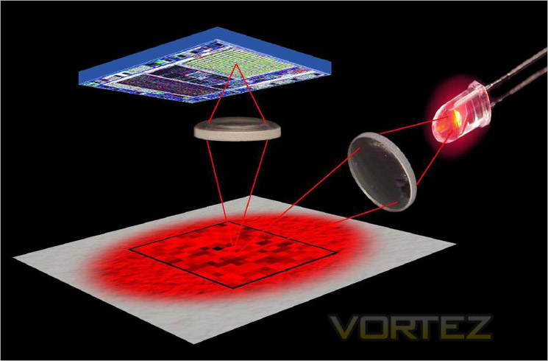
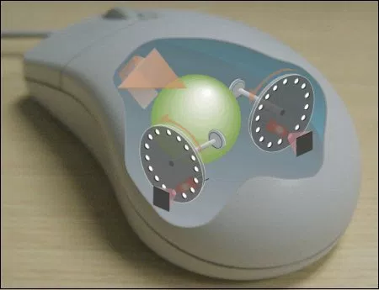
Mouse
Mouse
Types of mouse
Mechanical
Optical

Slide 7
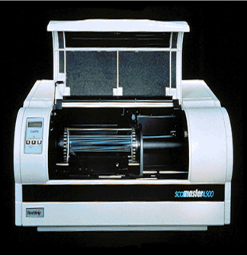
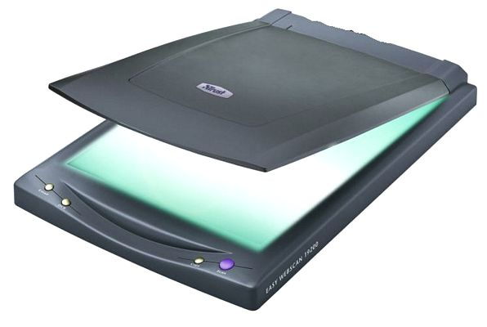
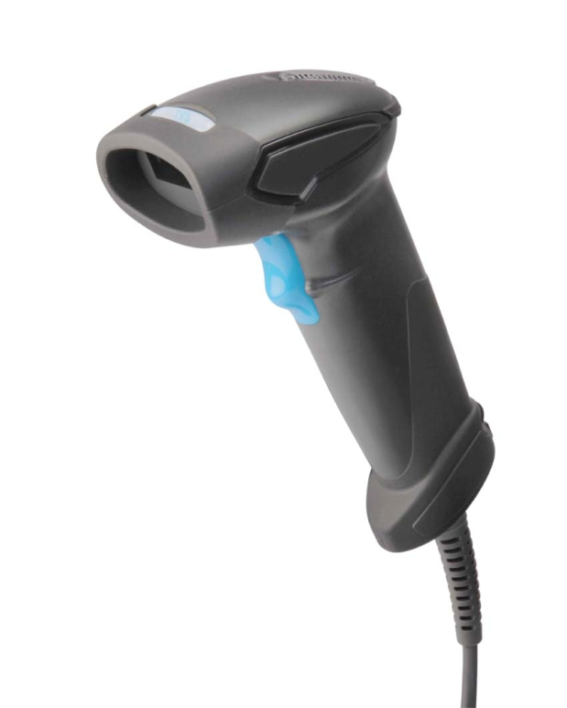
Scanner
Scanner
Types of scanner
Flatbed scanner
Drum scanner
Handheld scanner

Slide 8
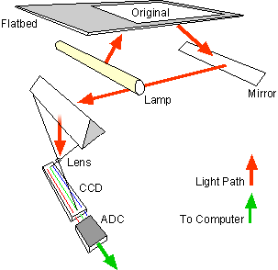
Working principle of scanner

Slide 9
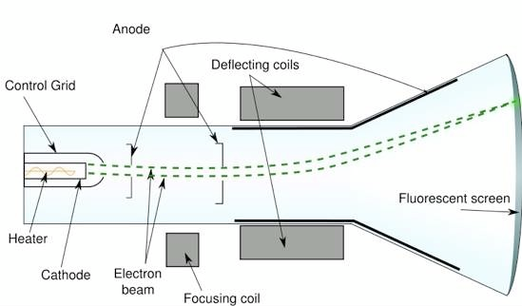
Output Devices
Monitor
CRT Monitor

Slide 10
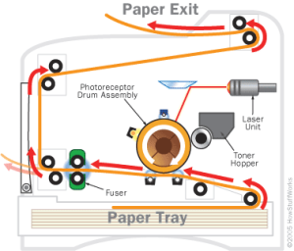
Laser printer
Components
Tonner hopper
Laser unit
Drum assembly
Fuser
Paper tray

Slide 11
Block Diagram Of SMPS
A switched-mode power supply (SMPS) is an electronic circuit that converts power using switching devices that are turned on and off at high frequencies
Step down Transformer
Bridge Rectifier
Filter
Voltage Regulator
Ac I/P
230v DC I/p
Feedback Circuit

Slide 12
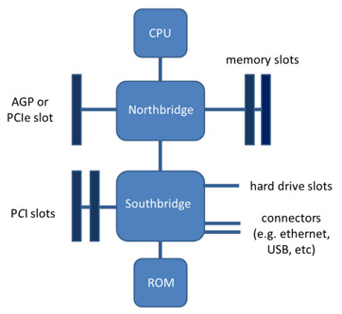
Motherboard
Mother board is also known as ‘Main board ‘.It holds and allows communication between many of the crucial electronic components of a system, such as the CPU and memory, and provides connectors for other peripherals.
North and South Bridge
Expansion slot- PCI
Memory slots
Hard drive slots

Slide 13
CPU
CISC | RISC
Includes multi-clock | Single-clock
complex instructions | reduced instruction only
high cycles per second, Small code sizes | Low cycles per second, large code sizes

Slide 14
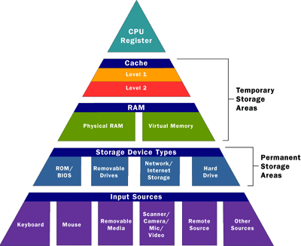
Memory

Slide 15
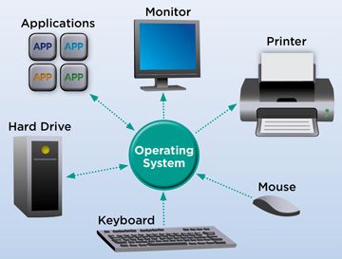
Introduction of windows
Operating System:
An operating system is software that communicates with the hardware and allows other programs to run.

Slide 16
KERNEL
Kernel is the heart of operating system
Types of Kernel:
1.Monolithic kernel
2.Micro kernel
3.Hybrid Kernel
Modes in Kernel:
1.User Mode
2.Kernel Mode

Slide 17
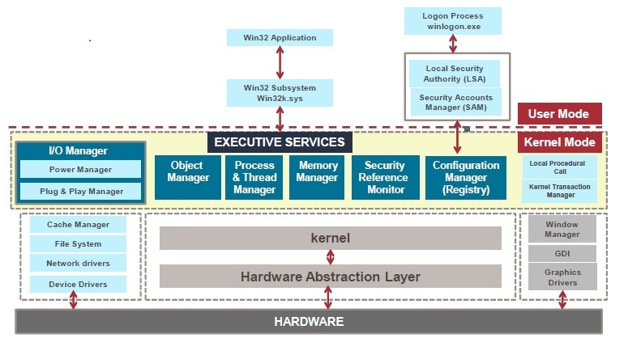
Kernel Architecture

Slide 18
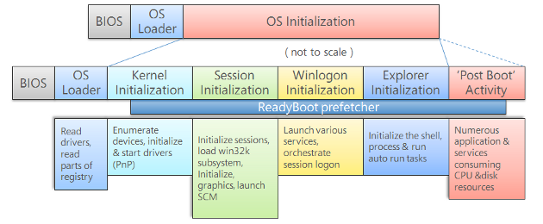
Windows booting process
BIOS Initialization

Slide 19
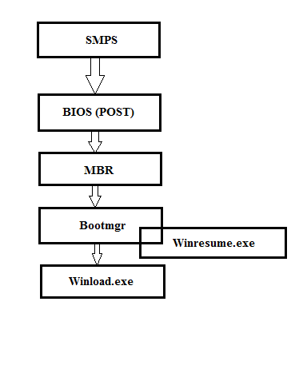
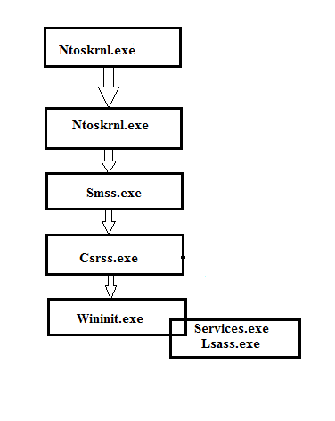
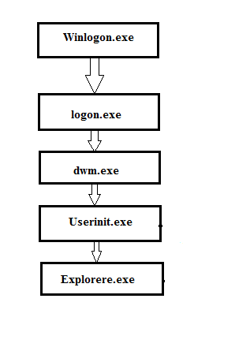
WINDOWS BOOTING PROCESS
Boot loading phase Kernel Loading Phase Logon Phase

Slide 20
FILE SYSTEM
TYPES OF WINDOWS FILE SYSTEM
FAT - File Allocation Table
NTFS - New Technology file System
TERMINOLOGY
DISK
PARTITION
VOLUME
ATTRIBUTE
FILE OPERATION

Slide 21
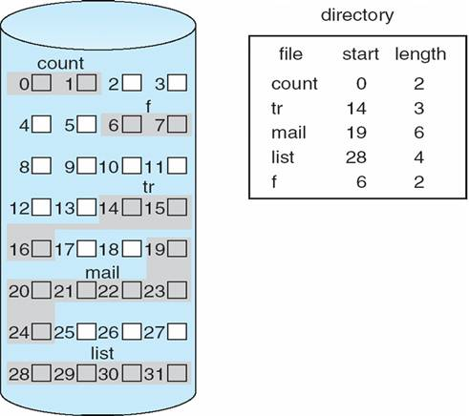
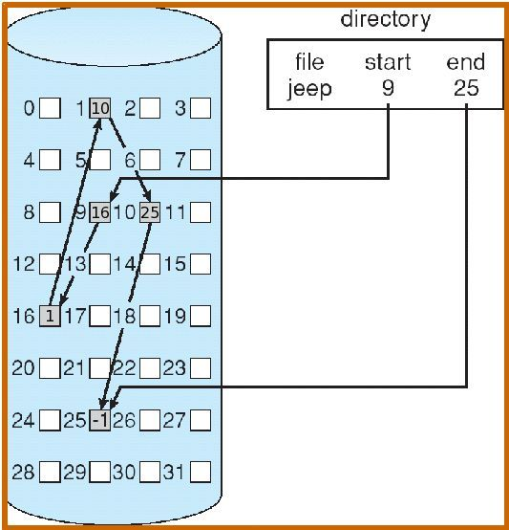
FILE SYSTEM
Contagious Allocation Linked Allocation

Slide 22
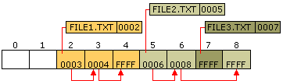
FILE SYSTEM
FAT – FILE ALLOCATION TABLE
File Allocation Table (FAT) is a file system that was created by Microsoft in 1977
It offers good performance even in lightweight implementations.

Slide 23
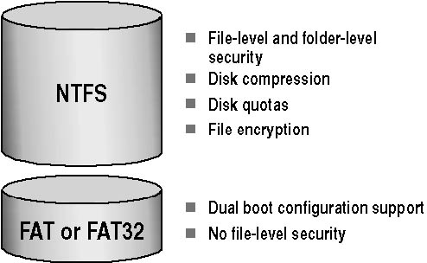
FILE SYSTEM
NTFS(New Technology File System)
Support for very large files (up to 2 to the 64th power or approximately 16 billion bytes in size)
Data recovery is easy comparing FAT32

Slide 24
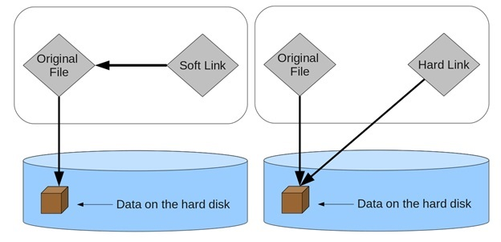
FILE SYSTEM
LINKS IN NTFS.
Soft Link
Hard Link

Slide 25
LINUX INTRODUCTION
Linux or, less frequently, is a Unix-like computer operating system assembled under the model of free and open-source software development and distribution.
The Unix operating system was conceived and implemented in 1969 at AT&T's Bell Laboratories in the United States.
Linux Kernel is an OS first released on September 17, 1991 by Linus Torvalds.

Slide 26
LINUX SUBSYSTEM
Memory Management
USER APPLICATIONS
OS SERVICES
LINUX KERNEL
HARDWARE CONTROLLERS
Virtual Files System
Process Scheduler
Inter-process Communication
Network Interface

Slide 27
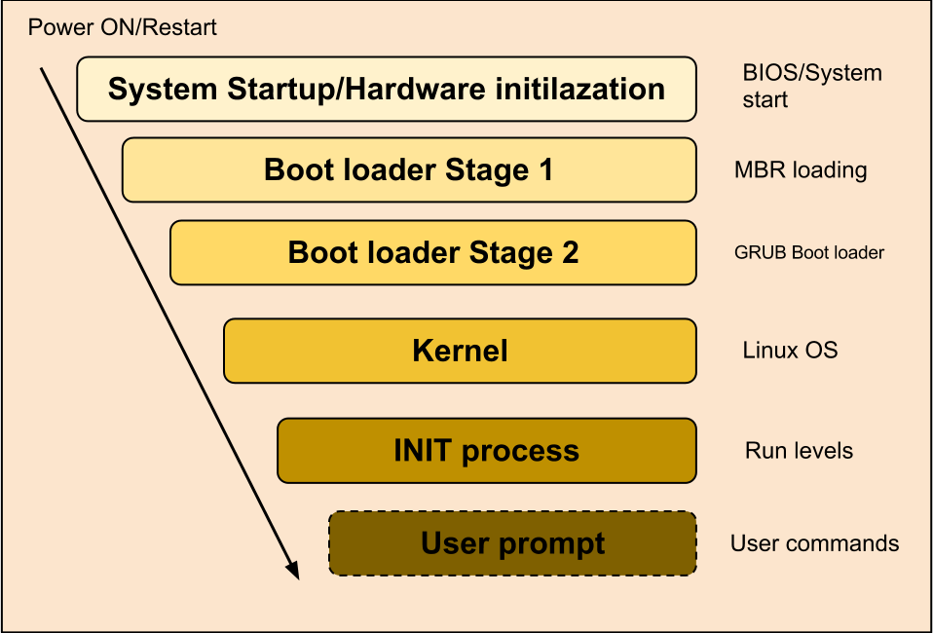
BOOTING PROCESS

Slide 28
BOOTING PROCESS
BIOS
When power button of the machine is ON, CPU looks out into ROM for further instruction.
The ROM contains JUMP function which tells the CPU to bring up the BIOS.
BIOS determines bootable devices availability.
Operating System tries to boot from Hard Disk where the MBR contains primary boot loader.

Slide 29
BOOT LOADER
BOOTING PROCESS
Stage 1
Boot Loader
Stage 2
Boot Loader
Boot time Menu
Kernel
Boot partition to use
Kernel files to load
Initial RAM disk file to use
/ boot / grup / grub.conf

Slide 30
KERNEL
BOOTING PROCESS
Memory Boot
File System
/ sbin / init
Start init process
Temporary root file system
Contains drivers to access partition
intrd

Slide 31
INIT
BOOTING PROCESS
/ sbin / init
Based on run levels
Start the services
First process starts with pid1
User / etc / inittab file to identify run levels

Slide 32
RUN LEVELS
BOOTING PROCESS
0 – halt
1 – Single user mode
2 – Multiuser, without NFS
3 – Full multiuser mode
4 – unused
5 – X11
6 – reboot

Slide 33
LOGIN
BOOTING PROCESS
/ sbin / init
Mingetty
Virtual Console
/etc/password
/etc/shadow

Slide 34
MEMORY MANAGEMENT
Page : The operating system retrieves data from secondary storage in same-size blocks called pages.
Paging : It is a memory management scheme by which a computer stores and retrieves data from secondary storage for use in main memory.
Page table : Stores the mapping between virtual and physical addresses.

Slide 35
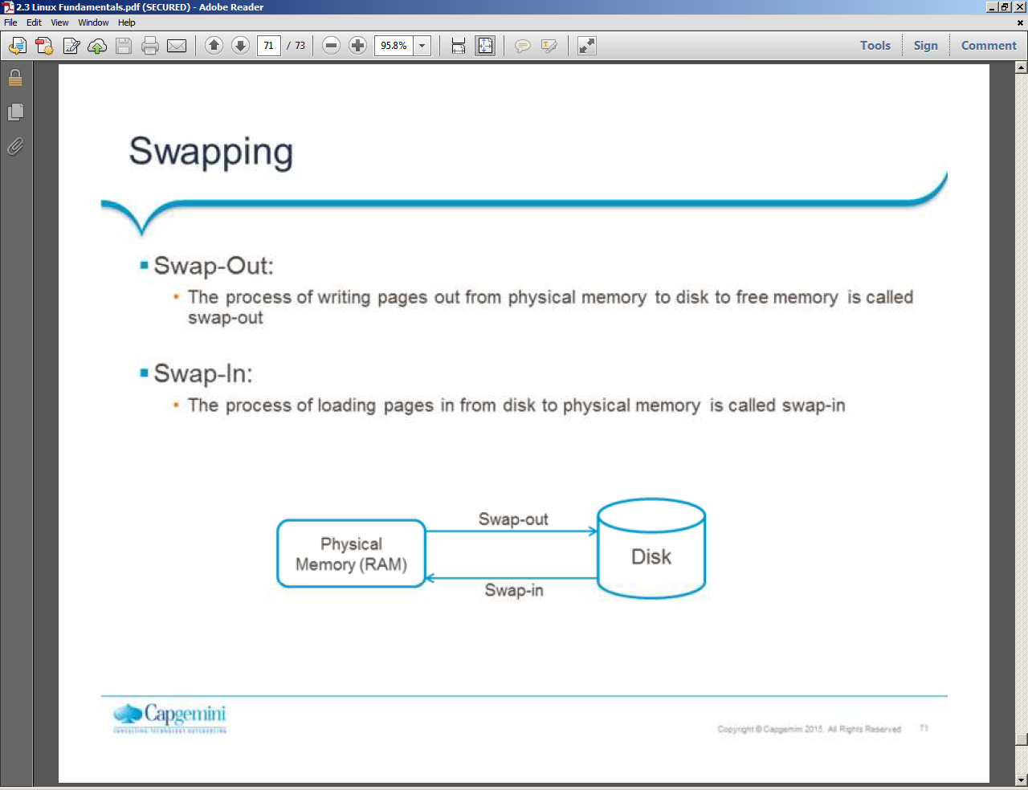
MEMORY MANAGEMENT
Swapping
Interchanging the pages between physical memory and disk is called swapping
When a process requires more memory than what is available, then swapping occurs by moving inactive page into disk.
Types of swapping
1.Swap-out
2.Swap-in

Slide 36
PROCESS MANAGMENT
An instance of a program is called a process.
OS tracks processes through a 5 digit ID number know as pid or process id.
Types of process
Child process
Daemon process
Orphan process
Zombie process
Interactive process
Automatic process
Real time process

Slide 37
PROCESS MANAGMENT
Types of process scheduling
FIFO
RR
Priority based
SJF

Slide 38
Fundamentals of Network
INCLUDES:
Network Architecture
Network Devices
Network Types
Network Topologies
OSI Layers

Slide 39
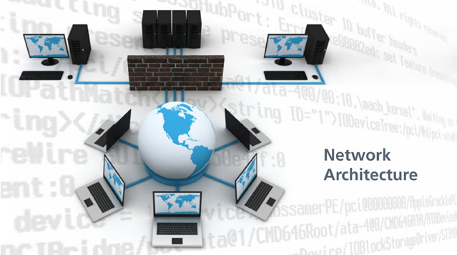
Fundamentals of Network
Network Architecture and Its Characteristics
Fault tolerance
Scalability
Quality of service
Security

Slide 40
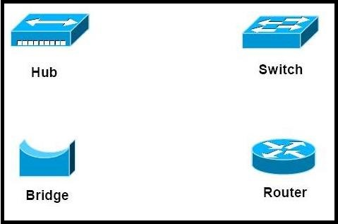
Fundamentals of Network
Network Devices

Slide 41
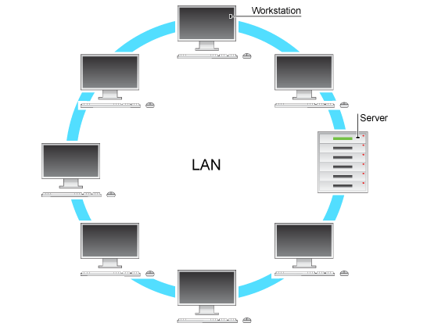
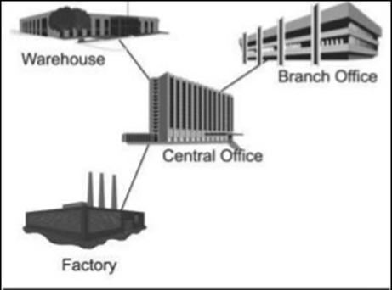
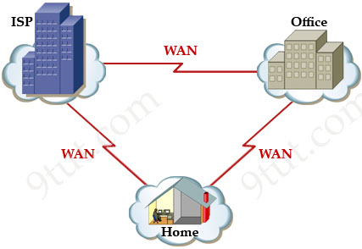
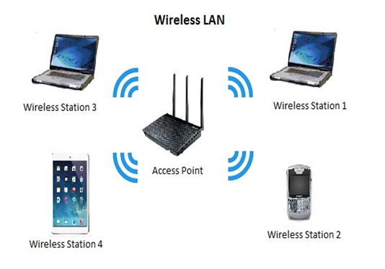
NETWORK TYPES
LAN(Local Area Network) WAN(Wide Area Network) MAN (Metropolitan Area Network)
WLAN(Wide Local Area Network)

Slide 42
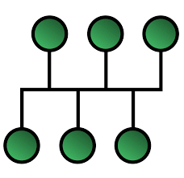
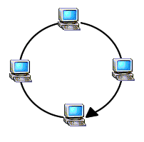
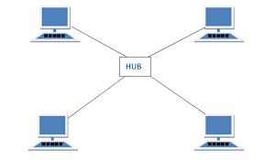

NETWORK TOPOLOGIES
Mesh Bus Ring Star

Slide 43
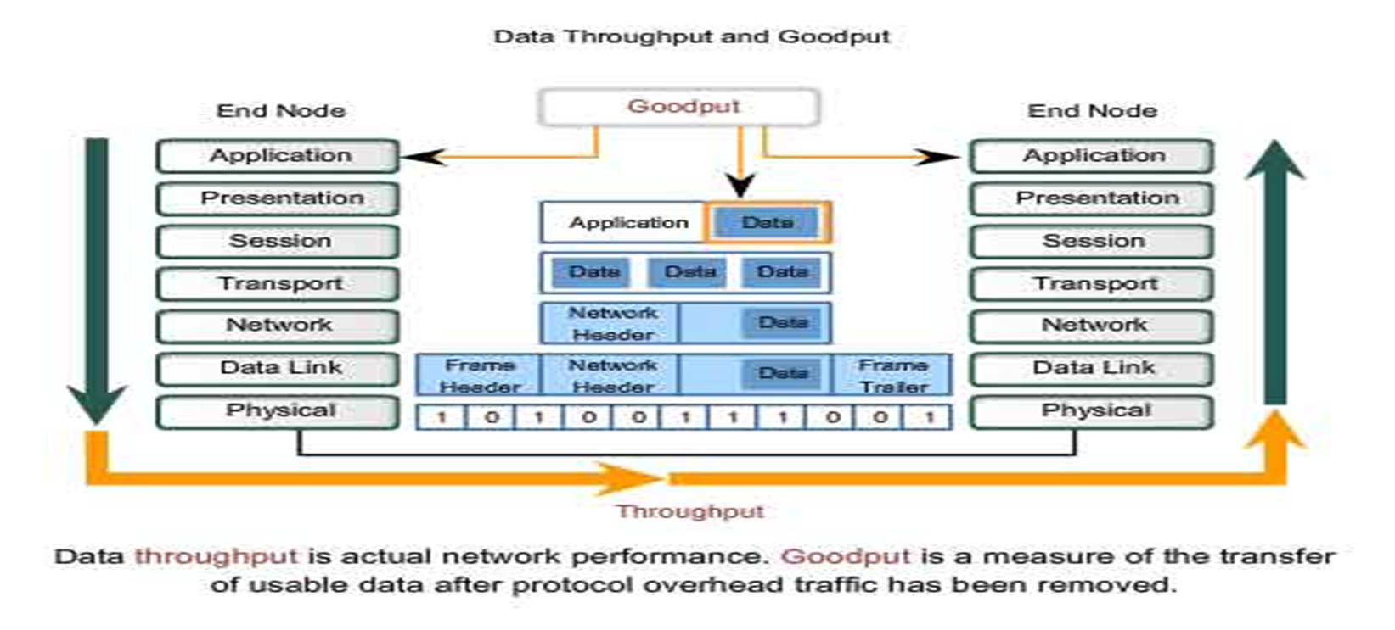
OSI LAYERS

Slide 44
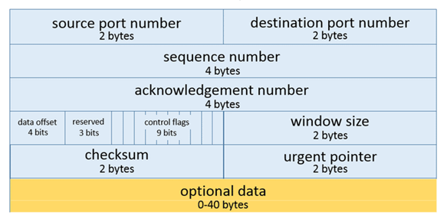
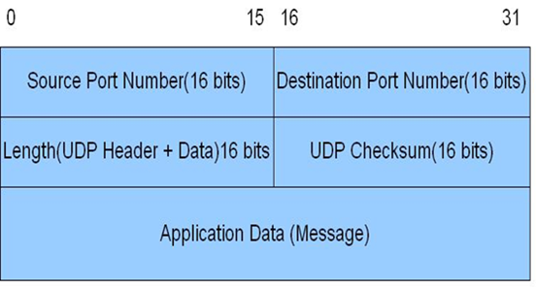
TCP and UDP Header
TCP Header UDP Header

Slide 45
IPV4 and IPV6
IPV4:
Internet Protocol version 4 (IPv4) is the fourth version of the Internet Protocol (IP) used to identify devices on a network through an addressing system. The Internet Protocol is designed for use in interconnected systems of packet-switched computer communication networks.
IPV6:
It is the newest version of the Internet Protocol (IP). IPv6 is often referred to as the "next generation Internet" because of its expanded capabilities and its growth through recent large scale deployments.

Slide 46
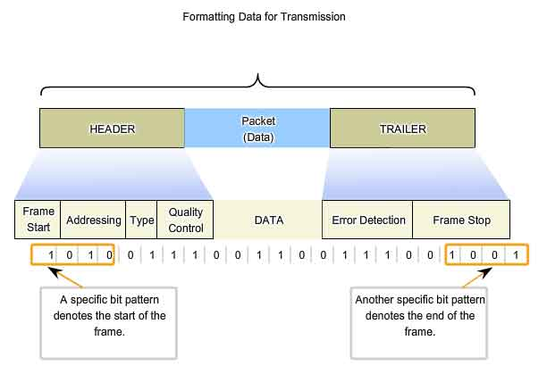
DATA LINK LAYER: CREATING FRAME

Slide 47
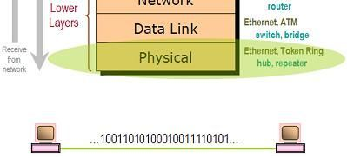
PHYSICAL LAYER
It defines connector and Interface Specification
Physical layer deals with communication media.
This layer receive frame from data link layer and convert them in bits.
It loads these bits on actual communication media.

Slide 48
FUTURE SCOPE
Needs to employ more efficient techniques for fault tolerance.
Needs to be implemented in wireless sensor networks with mobile nodes.
Needs to provide more secure way of Data transmission.
Everything on INTERNET.
Everybody on INTERNET.

Slide 49
Network Services
DHCP
DNS
Directory Services
Mail Services
Proxy Service

Slide 50
DHCP SERVER
Dynamic Host Configuration Protocol(DHCP) is a network protocol that enables a server to automatically assigns an IP address to a computer.
Three mechanisms to allocate IP address to hosts
Automatic Allocation
Dynamic Allocation
Manual Allocation

Slide 51
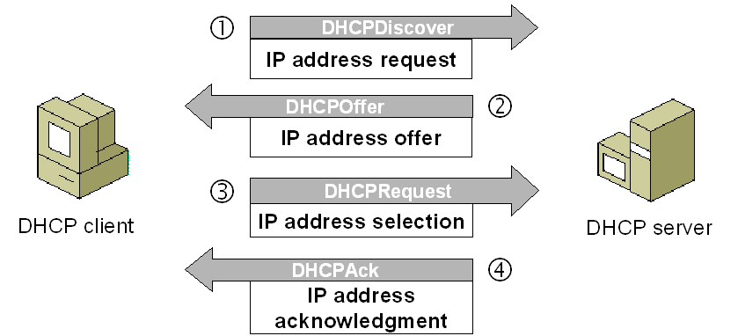
DHCP
DHCP Client & Server’s Operations
DHCP DISCOVER
DHCP OFFER
DHCP REQUEST
DHCP ACK

Slide 52
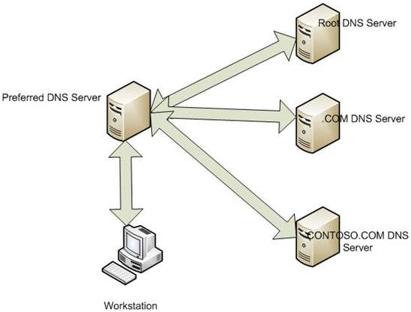
DNS SERVER
DNS resolves domain names into IP address and vice versa.
Resolution Process

Slide 53
Directory Services
Directory services are network services that identify every resource such as email address, peripheral devices and computers on the network, and make these resources accessible to users and applications.
Examples of directory services
LDAP- Lightweight Directory Access Protocol
It is used to provide directory services.
It is used in Authentication.

Slide 54
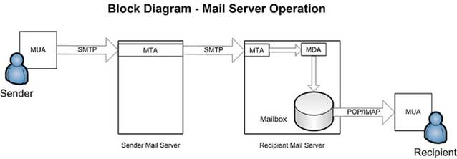
Mail services
Mail user agent (MUA)
Mail transfer agent (MTA)
Mail deliver agent (MDA)

Slide 55
PROXY
PC
PC
PROXY
WEB SERVER
PC

Slide 56
Types Of Proxy
FORWARD PROXY
REVERSE PROXY
TRANSPARENT PROXY
OPEN PROXY

Slide 57
Now its your turn
Q DHCP (dynamic host configuration protocol) provides _____ to the client. a) IP address b) MAC address c) url d) none of the mentioned

Slide 58
DATABASE
What is Database.
A database is an organized collection of data.
The main purpose of database is to operate large amount of information by storing, retrieving and managing.
There are many database available like MySQL, Sybase, Oracle, Mango DB, Informix, Postgre, SQL Server etc.

Slide 59
DBMS
Database Management System (DBMS) is a collection of programs which enables its users to access database, manipulate data, reporting / representation of data .
It also helps to control access to the database.
Database Management Systems are not a new concept and as such had been first implemented in 1960s.

Slide 60
ACID PROPERTIES
Atomicity
Consistency
Isolation
Durability

Slide 61
RDBMS
RDBMS stands for Relational Database Management Systems.
Data is represented in terms of tuples(rows) in RDBMS.
Relational database is most commonly used database. It contains number of tables and each table has its own primary key.
Due to a collection of organized set of tables, data can be accessed easily in RDBMS.

Slide 62
Normalization
Normalization is a systematic approach of decomposing tables to eliminate data redundancy and undesirable characteristics like Insertion, Update and Deletion Anamolies.
Normalization is used for mainly two purpose:-
Eliminating reduntant(useless) data.
Ensuring data dependencies make sense i.e data is logically stored.
Normalization is divided into following normal forms:
First Normal Form (1NF)
Second Normal Form (2NF)
Third Normal Form (3NF)
Boyce-Codd Normal Form (BCNF)

Slide 63
1st Normal form
There are no repeating or duplicate fields.
Each cell contains only a single value.
Each record is unique.
Student
Student
Student_id | Student_Name | Address | Subject
100 | Joseph | Alaiedon township | mathematics
100 | joseph | Alaiedon township | Physics
101 | Allen | Fraser township | chemistry
101 | Allen | Fraser township | Physics
102 | Chris | Clinton township | chemistry
103 | Pattay | Troy | Physics
Student_id | Student_Name | Address | Subject
100 | Joseph | Alaiedon township | Mathematics, Physics
101 | Allen | Fraser township | Chemistry, physics
102 | Chris | Clinton township | chemistry
103 | Pattay | Troy | Physics

Slide 64
2nd Normal Form
A table is said to be in 2NF if both the following conditions hold:
Table is in 1NF (First normal form)
No non-prime attribute is dependent on the proper subset of any candidate key of table.
An attribute that is not part of any candidate key is known as non-prime attribute.
Subject
Student
Student_id | Subject
100 | mathematics
100 | Physics
101 | chemistry
101 | Physics
102 | chemistry
103 | Physics
Student_id | Student_Name | Address
100 | Joseph | Alaiedon township
101 | Allen | Fraser township
102 | Chris | Clinton township
103 | Pattay | Troy

Slide 65
3rd Normal Form
It should meet all the requirements of both 1NF and 2NF
If there is any columns which are not related to primary key, then remove them and put it in a separate table, relate both the table by means of foreign key i.e.; there should not be any transitive dependency.
student
Subject
Student
Student_id | Student_Name | Zip | Street | City
100 | Joseph | 48035 | Alaiedon village Drive | Alaiedon township
101 | Allen | 48036 | Fraser village Drive | Fraser township
102 | Chris | 48038 | Clinton village Drive | Clinton township
103 | Patty | 48039 | Troy village Drive | Troy
Zip | Street | City
48035 | Alaiedon village Drive | Alaiedon township
48036 | Fraser village Drive | Fraser township
48038 | Clinton village Drive | Clinton township
48039 | Troy village Drive | Troy
Student_id | Student_Name | Zip
100 | Joseph | 48035
101 | Allen | 48036
102 | Chris | 48038
103 | Patty | 48039

Slide 66
Boyce and Codd Normal Form (BCNF)
Boyce and Codd Normal Form is a higher version of the Third Normal form. This form deals with certain type of anamoly that is not handled by 3NF.
A 3NF table which does not have multiple overlapping candidate keys is said to be in BCNF.

Slide 67
SQL language statement
SQL language statement
DDL
DML
DCL
TCL
Create
Alter
Truncate
Drop
Insert
Update
Delete
Select
Grant
Revoke
Commit
Rollback

Slide 68
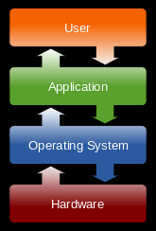
APPLICATIONS
An Application or Application software is a program that is designed and built to satisfy a particular requirement.
An Application runs a platform usually an operating system, which in turn runs on the hardware platform.

Slide 69
APPLICATIONS
Components of Application
Presentation Logic
Eg. In Calculator
Display result, Receive input
Business logic
Apply logics
Data Persistence Logic
Stores Results

Slide 70
Life cycle of application
Requirement
Design
Build and Test
Deploy
Operate and Optimize

Slide 71
Types of Application
Parameters | Compiled Application | Interpreted Application
Input | Takes entire program as input | Takes single line of code or instruction
Output | Generates immediate object code | Does not generates immediate object code
Speed | Faster | Slower
Memory | Requires more memory to generate object code | Requires less memory
Errors | Displays error once entire program is checked | Displays error when each instruction is executed

Slide 72

API- Application Programming Interface
An API is a set of specification sending and receiving data between
applications in binary terms instead of User Interfaces.

Slide 73
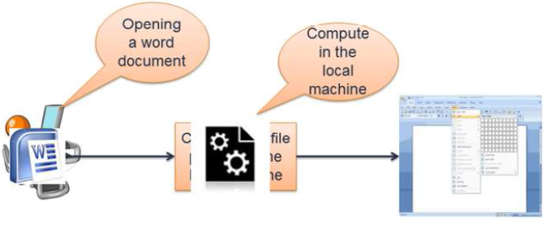
APPLICATIONS ARCHITECTURE TYPES
Thick Client Application
Also called as heavy clients.
These are full featured computers that are connected to a network.
These are functional whether they are connected to network or not.
.

Slide 74
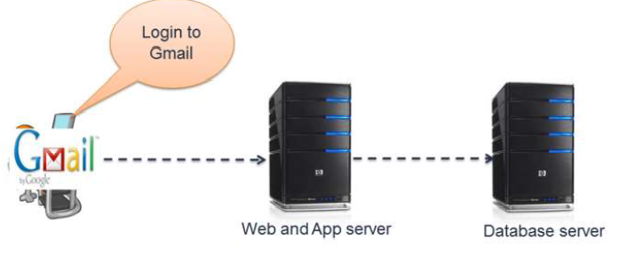
Application Architecture Types
Thin Client application
These applications relies on the network to process the data.
A thin client is a network computer without a hard disk drive.

Slide 75
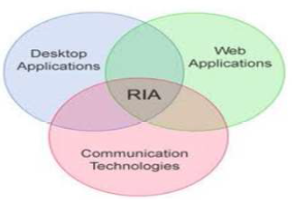
Application Architecture Types
Rich Internet Application
It is a Web application that has many of the characteristics of desktop application software, typically delivered by way of a site-specific browser, a browser plug-in, an independent sandbox, extensive use of JavaScript, or a virtual machine.
Ex. Adobe Flash, JavaFX, and Microsoft Silverlight are currently the three most common platforms.

Slide 76
TIER
Physical Separation of presentation, Business services and data functionality of your design across separate computers and system.
Types
2- Tier
3- Tier

Slide 77
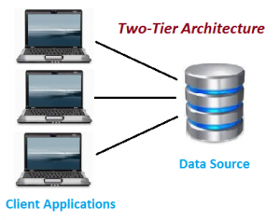
2 - Tier
The two-tier architecture is like client server application.
The direct communication takes place between client and server. There is no intermediate between client and server.
Because of tight coupling a 2 tiered application will run faster.

Slide 78
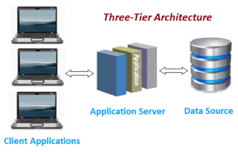
3 - Tier
Three-tier architecture typically comprise a presentation tier, a business or data access tier, and a data tier.
Three layers in the three tier architecture are as follows:
Client layer Business layer Data layer

Slide 79
STORAGE
Storage means the devices and data connected to the computer through I/O operations.
Components of Storage System Environment
Hosts
Connectivity
Bus, Port, Cable
Storage arrays
Magnetic media, Optical media, Solid State media

Slide 80
Types of Storage
Direct attached Storage (DAS)
Network Attached Storage (NAS)
Storage Area Networks (SAN)
Redundant Array of Independent Disk (RAID)
Just Bunch od Disk (JBOD)

Slide 81
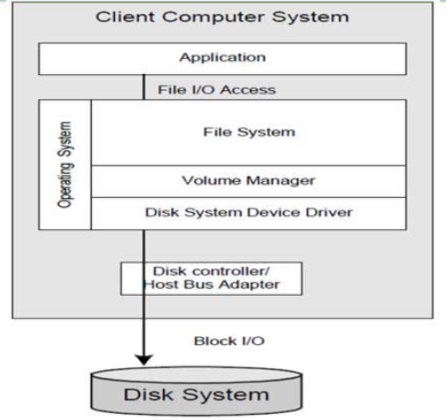
Direct attached Storage (DAS)
Directly attached to the Servers.
Applications uses Block-level access protocols to access the data.

Slide 82

Network Attached Storage (NAS)
It is Storage over a network.
It uses File-level access.
File I/O is a higher-level type of request that specifies the file to be accessed, but not specify its logical block address.

Slide 83

Storage Area Network
SAN serves to interconnect storage related resources that are connected to multiple servers.
It uses Fiber Channel Technology.
It also uses iSCSI.

Slide 84
SAN Connectivity Methods
Point to point (FC-P2P)
A direct connection between the nodes.
Fiber Channel- Arbitrated Loop (FC-AL)
Devices are attached to a Shared loop.
Fiber Channel- Switched Fabric (FC-SW)
Multiple devices are connected via switching technologies.

Slide 85
RAID
Stands for Redundant Array of Independent Disks.
Conceptually it uses two or more physical disks, to create one logical disk.
RAID levels
RAID 0
RAID 1
RAID 5
RAID 6
RAID 01
RAID 10

Slide 86


RAID 0 and RAID 1

Slide 87


RAID 5 and RAID 6

Slide 88


RAID 01 and RAID 10

Slide 89
SUMMARY
Hardware
Windows
Linux
Network Fundamentals
Network Services
Database
Applications
Storage

Slide 90
Thank you

